Slide 1







Thành Viên trong nhóm
GROUP 04
---------- NETWORK PROGRAMMING
GROUP MEMBER:
Tên
Mã Sinh Viên
Tên
Mã Sinh Viên
Tên
Mã Sinh Viên
Tên
Mã Sinh Viên
Vũ Đức An - 20215174
Trịnh Diễm Quỳnh - 20215174
1.

Slide 2



Thành Viên trong nhóm
Tên
Mã Sinh Viên
Tên
Mã Sinh Viên
Tên
Mã Sinh Viên
Tên
Mã Sinh Viên
Hello!
Chat Application
Hi! Nice to meet you.
2.
Chèn hình ảnh bạn thích
Chèn ảnh
Chèn ảnh 2

Slide 3

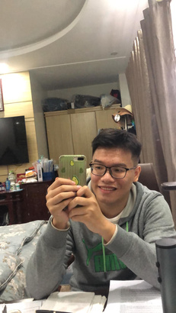







Nội dung thuyết trình
Thành Viên trong nhóm
Môn học Thuyết trình
Group
Name
Chèn hình ảnh bạn thích
Chèn ảnh
Chèn ảnh 2
TABLE OF CONTENTS
1. OBJECTIVES
2. APPLICATION SCRIPTS
3. APPLICATION DESIGN
4. PLATFORM/TOOLS
5. APPLICATION PROTOCOL
6. RESULTS
7. TASK ASSIGNMENT
8. DIFFICULTIES AND RESOLUTION
9. FUTURE PLANS
3.
10. PROGRAM DEMONSTRATION

Slide 4
Nội dung thuyết trình
Thành Viên trong nhóm
Môn học Thuyết trình
Group
Name
Chèn hình ảnh bạn thích
Chèn ảnh
Chèn ảnh 2
1. OBJECTIVES
Building a Chat Application:
Enable users to send and receive messages in real-time.
Implement basic user authentication for secure communication.
Support one-on-one messaging between users and allow group conversation. Allow users to see member list, add/remove members and leave chat rooms.
Provide a friendship feature.
Offline messaging and save old conversation
4.

Slide 5
2. APPLICATION SCRIPTS
There’re 4 main actions:
Authentication: Users can login/register/logout in the system.
User list manipulation: The program shows friend list and online list. Users can send a friend request to online users.
Room list manipulation: The program shows the list of all the conversations of the user. Users can create a new group chat and add/remove members.
Messaging: Users send messages to one another or to a group chat.
5.

Slide 6
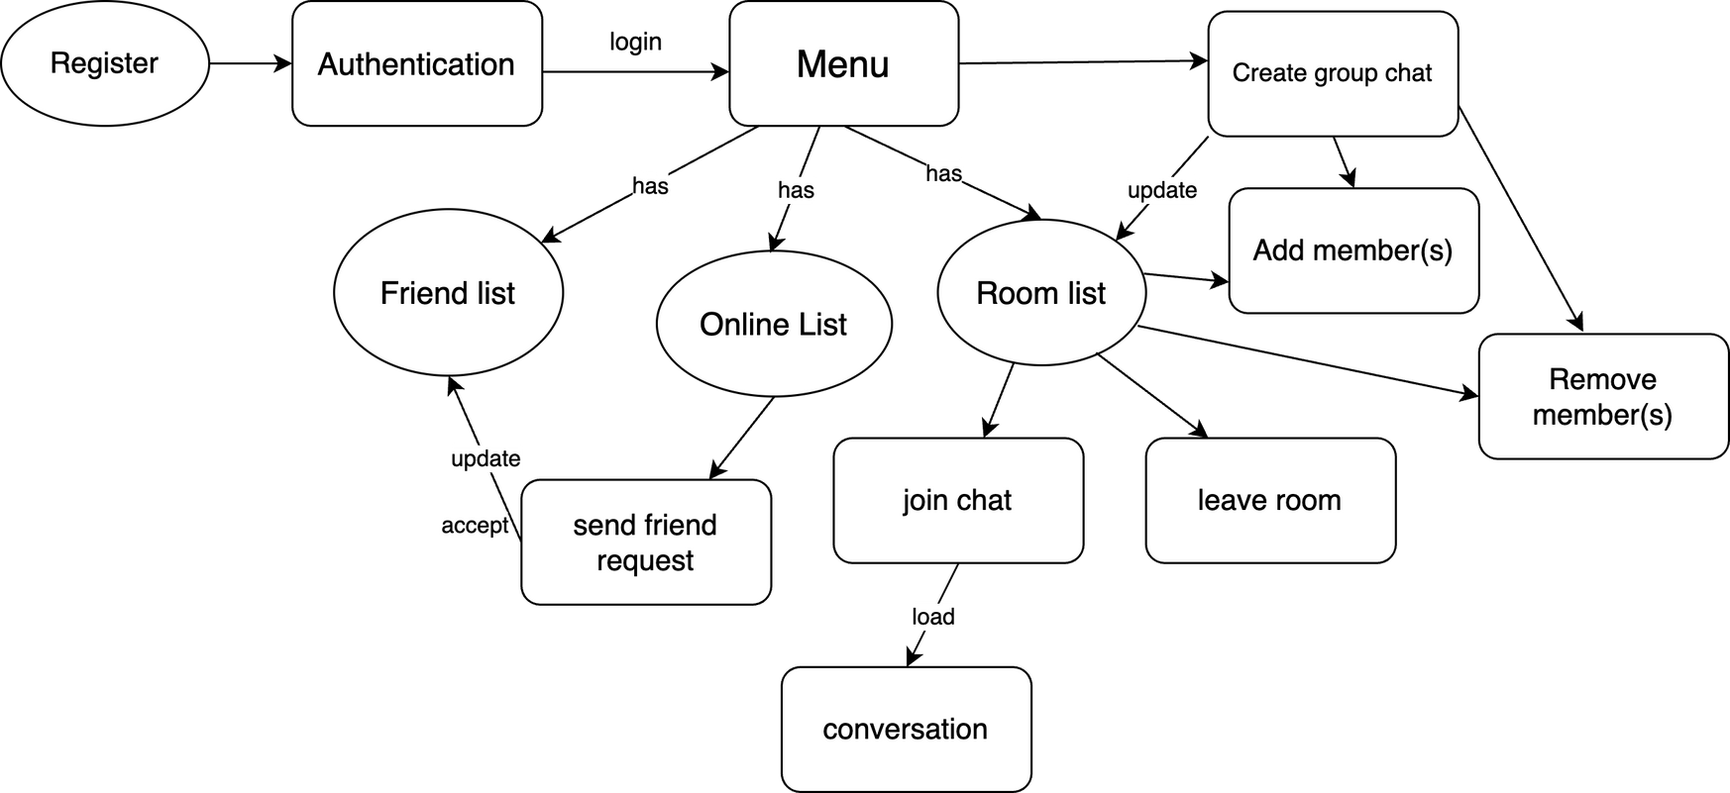
3. APPLICATION DESIGN
6.

Slide 7
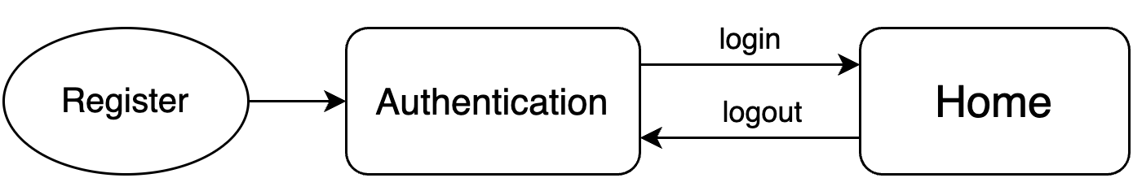
3. APPLICATION DESIGN
Authentication:
Menu
At first, the user needs to login for the program to load the home page. If the user doesn’t have an account, they can sign up with an available username and password.
7.

Slide 8
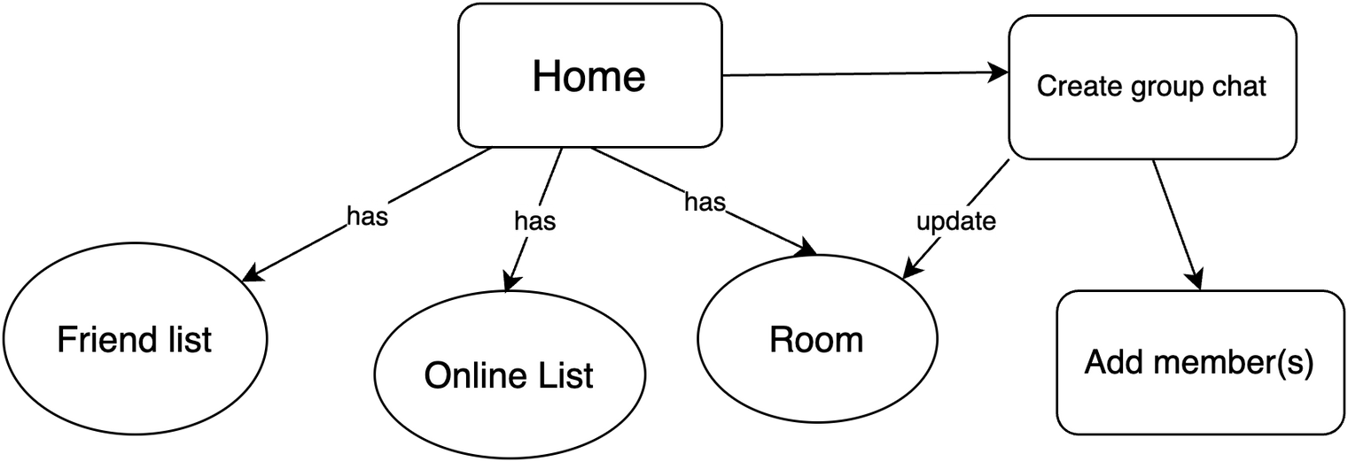
3. APPLICATION DESIGN
Menu:
Menu
The user can load the online list, the user’s friend list and all the chats they are in.
There’s an option to create a new group chat on the menu as well. The room(group chat) list will be update accordingly.
8.

Slide 9
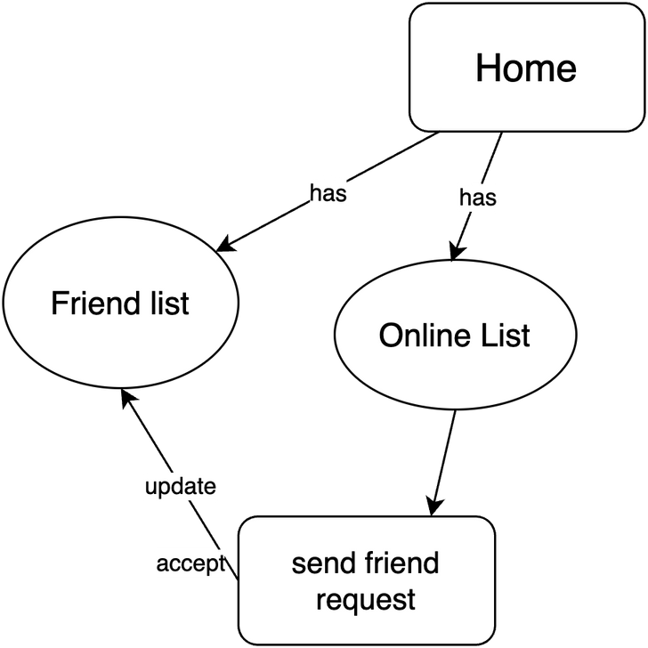
3. APPLICATION DESIGN
Adding a friend:
Menu
Users can send friend requests to other users.
When the request is accepted, their friend list is updated and a new private chat between the two users is created.
9.

Slide 10
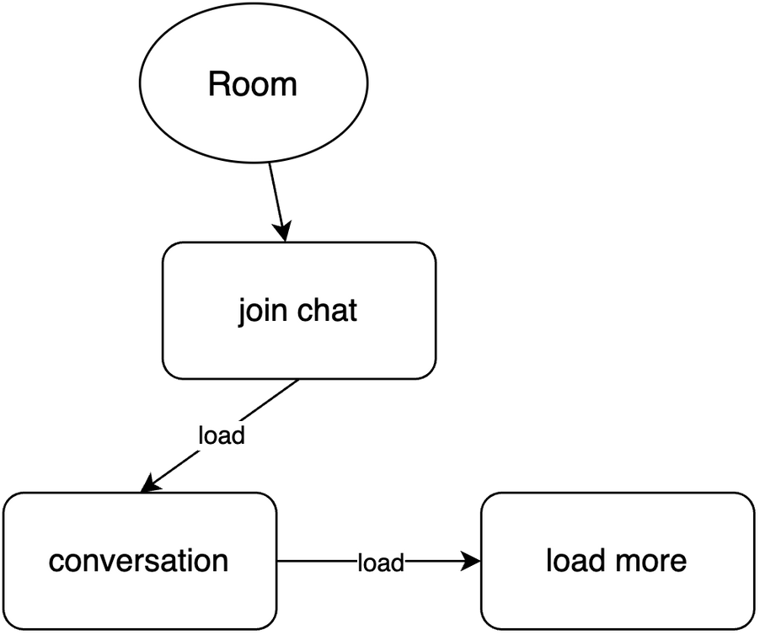
3. APPLICATION DESIGN
Sending a message:
The chat room list includes both private one-on-one and group conversations.
To send a new message in a conversation, the user chooses that chat room and they can load the latest 100 messages will be loaded.
10.

Slide 11
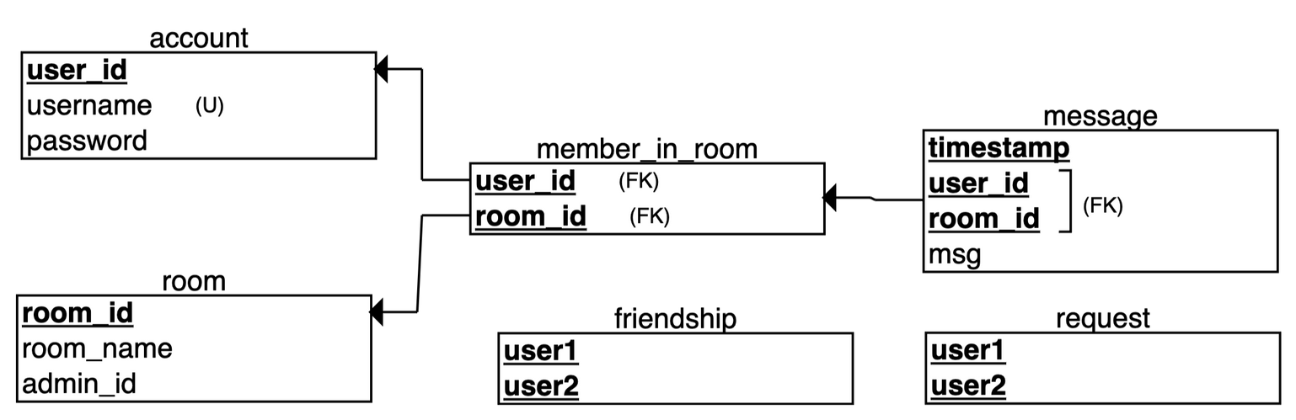
3. APPLICATION DESIGN
Database design:
The database saves user information and messages sent.
The friendship and request tables are for managing friendships.
11.

Slide 12


4. PLATFORM/TOOLS
Programming Language: Use C for the core logic and functionality.
PostgreSQL for Database
Hello!
12.
Hi! Nice to meet you.

Slide 13
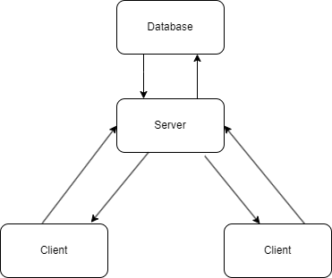
5. APPLICATION PROTOCOL
TCP protocol: TCP is used to reduce data loss.
Multithreading: to efficiently manage multiple chat rooms and users.
Non-blocking IO: for sending and receiving messages in real-time, ensuring that the server can efficiently handle a large number of concurrent message transmissions without blocking on I/O operations.
13.
Hello!
Hi! Nice to meet you.

Slide 14
5. APPLICATION PROTOCOL
TCP protocol: TCP is used to reduce data loss.
Multithreading: to efficiently manage multiple chat rooms and users.
Non-blocking IO: for sending and receiving messages in real-time, ensuring that the server can efficiently handle a large number of concurrent message transmissions without blocking on I/O operations.
Len1 (4B) | Param1 (len1 B) | Len2 (4B) | Param1 (len2 B) | Len3 (4B) | Param3 (len3 B)
Opcode (4 bytes) | Function (4 bytes)
Payload (variable length)
14.
Hello!
Hi! Nice to meet you.

Slide 15
5. APPLICATION PROTOCOL
TCP protocol: TCP is used to reduce data loss.
Multithreading: to efficiently manage multiple chat rooms and users.
Non-blocking IO: for sending and receiving messages in real-time, ensuring that the server can efficiently handle a large number of concurrent message transmissions without blocking on I/O operations.
Len1 (4B) | Param1 (len1 B) | Len2 (4B) | Param2 (len2 B) | Len3 (4B) | Param3 (len3 B)
Payload (variable length)
15.
Hello!
Hi! Nice to meet you.

Slide 16
5. APPLICATION PROTOCOL
1. Authentication:
Login: The client sends parameters, including a “username” and “password”, to the server. The server searches the database to authenticate the information.
Opcode (4 bytes) | Function (4 bytes)
Len1 (4B) | Param1 (len1 B) | Len2 (4B) | Param2 (len2 B) | Len3 (4B) | Param3 (len3 B)
Client- Server: Op = 0, Func = 1, Parameters: ["username", "password"]
Server- Client: Op = 0, Func = 1, return {success, error}
16.
Hello!
Hi! Nice to meet you.

Slide 17
5. APPLICATION PROTOCOL
1. Authentication:
Get online list: After the login process, if the authentication returns 1 (true), the server records client activities in the log and updates the list of online clients. When a user sends request for the online list, the server sends back the online list.
Opcode (4 bytes) | Function (4 bytes)
Len1 (4B) | Param1 (len1 B) | Len2 (4B) | Param2 (len2 B) | Len3 (4B) | Param3 (len3 B)
Client- Server: Op = 0, Func = 0, Parameters: None
Server- Client: Op = 0, Func = 0, return Parameter: [”username”]
17.
Hello!
Hi! Nice to meet you.

Slide 18
5. APPLICATION PROTOCOL
1. Authentication:
Register: The client sends a desired “username” along with a “password” to the server. The server checks if the username is available, if it is, the server then inserts the information into the database and sends “user_id” back as a confirmation to the client.
Opcode (4 bytes) | Function (4 bytes)
Len1 (4B) | Param1 (len1 B) | Len2 (4B) | Param2 (len2 B) | Len3 (4B) | Param3 (len3 B)
Client- Server: Op = 0, Func = 2, Parameters: ["username", "password"]
Server- Client: Op = 0, Func = 2, return Parameter: ["user_id"]
18.
Hello!
Hi! Nice to meet you.

Slide 19
5. APPLICATION PROTOCOL
1. Authentication:
Change Password: The client sends information including “username”, “old_password” and “new_password” to change the password. The server checks the feasibility of this query and returns .
Opcode (4 bytes) | Function (4 bytes)
Len1 (4B) | Param1 (len1 B) | Len2 (4B) | Param2 (len2 B) | Len3 (4B) | Param3 (len3 B)
Client- Server: Op = 0, Func = 3, Parameters: ["username", "old_password", "new_password"]
Server- Client: Op = 0, Func = 3, return {success, error}
19.
Hello!
Hi! Nice to meet you.

Slide 20
5. APPLICATION PROTOCOL
2. User list manipulation:
Get Friend List: The client sends a “username” to the server. The server searches for all users who have added the client as a friend and sends the list back to the client.
Opcode (4 bytes) | Function (4 bytes)
Len1 (4B) | Param1 (len1 B) | Len2 (4B) | Param2 (len2 B) | Len3 (4B) | Param3 (len3 B)
Client- Server: Op = 1, Func = 0, Parameters: ["username"]
Server- Client: Op = 1, Func = 0, return Parameters: ["username"]
20.
Hello!
Hi! Nice to meet you.

Slide 21
5. APPLICATION PROTOCOL
2. User list manipulation:
Get Request list: The client sends username for server to retrieve all the friend requests others have sent to the said user.
Opcode (4 bytes) | Function (4 bytes)
Len1 (4B) | Param1 (len1 B) | Len2 (4B) | Param2 (len2 B) | Len3 (4B) | Param3 (len3 B)
Client- Server: Op = 1, Func = 3, Parameters: ["username"]
Server- Client: Op = 1, Func = 3, return Parameters: ["username"]
21.
Hello!
Hi! Nice to meet you.

Slide 22
5. APPLICATION PROTOCOL
2. User list manipulation:
Add friend: The client sends “username 1”(source) and “username 2”(destination) to the server. The server checks if the friendship already exists and returns a confirmation. When a new friendship is created, a private chatroom between the two users is also automatically created.
Opcode (4 bytes) | Function (4 bytes)
Len1 (4B) | Param1 (len1 B) | Len2 (4B) | Param2 (len2 B) | Len3 (4B) | Param3 (len3 B)
Client- Server: Op = 1, Func = 2, Parameters: ["destination", "username"]
Server- Client: Op = 1, Func = 2, return {success, error}
22.
Hello!
Hi! Nice to meet you.

Slide 23
5. APPLICATION PROTOCOL
3. Room list manipulation
Get Room List: The client sends “username” and the server sends back information about room IDs and room names to the client, indicating the rooms the user belongs to. If it’s a private room, the room name is the name of the other user.
Opcode (4 bytes) | Function (4 bytes)
Len1 (4B) | Param1 (len1 B) | Len2 (4B) | Param2 (len2 B) | Len3 (4B) | Param3 (len3 B)
Client- Server: Op = 2, Func = 0, Parameters: ["username"]
Server- Client: Op = 2, Func = 0, return Parameters: [ "room_id", "roomname" ]
23.
Hello!
Hi! Nice to meet you.

Slide 24
5. APPLICATION PROTOCOL
3. Room list manipulation
Get Member List: The client sends “room_id” and the server retrieves a list of users in the room and sends it back to the client.
Opcode (4 bytes) | Function (4 bytes)
Len1 (4B) | Param1 (len1 B) | Len2 (4B) | Param2 (len2 B) | Len3 (4B) | Param3 (len3 B)
Client- Server: Op = 2, Func = 1, Parameters: ["room_id"]
Server- Client: Op = 2, Func = 1, return Parameters: ["username"]
24.
Hello!
Hi! Nice to meet you.

Slide 25
5. APPLICATION PROTOCOL
3. Room list manipulation
Create a new Room: The client sends the “username” of the user that wants to make a group chat. The server initiates the creation of a room, setting that user as the admin, and the server sends back the room ID to the client.
Opcode (4 bytes) | Function (4 bytes)
Len1 (4B) | Param1 (len1 B) | Len2 (4B) | Param2 (len2 B) | Len3 (4B) | Param3 (len3 B)
Client- Server: Op = 2, Func = 2, Parameters: ["room_name", “username”]
Server- Client: Op = 2, Func = 2, return Parameters: ["room_id"]
25.
Hello!
Hi! Nice to meet you.

Slide 26
5. APPLICATION PROTOCOL
3. Room list manipulation
Add a member: The client sends the “username” to be added and the “room_id” to the server. The server sends a confirmation back to the client.
Opcode (4 bytes) | Function (4 bytes)
Len1 (4B) | Param1 (len1 B) | Len2 (4B) | Param2 (len2 B) | Len3 (4B) | Param3 (len3 B)
Client- Server: Op = 2, Func = 3, Parameters: ["room_name", “username”]
Server- Client: Op = 2, Func = 3, return Parameters: ["room_id", “username”]
26.
Hello!
Hi! Nice to meet you.

Slide 27
5. APPLICATION PROTOCOL
3. Room list manipulation
Remove member: The client sends the “username” of the user they want to remove and the “room_id”. The server sends a confirmation back to the client.
This protocol is also used for when an user want to leave a chat room.
Opcode (4 bytes) | Function (4 bytes)
Len1 (4B) | Param1 (len1 B) | Len2 (4B) | Param2 (len2 B) | Len3 (4B) | Param3 (len3 B)
Client- Server: Op = 2, Func = 4, Parameters: ["room_name", “username”]
Server- Client: Op = 2, Func = 4, return Parameters: ["room_id", “username”]
27.
Hello!
Hi! Nice to meet you.

Slide 28
5. APPLICATION PROTOCOL
4. Messaging
Get conversation of a room: The client sends a request for the conversation of a room with “room_id”. The server proceeds to retrieve a list of timestamps where a message is sent within the room before the current timestamp. Then the server would load the content of each message with the room ID and the specific timestamp. The server sends back the requested information.
Opcode (4 bytes) | Function (4 bytes)
Len1 (4B) | Param1 (len1 B) | Len2 (4B) | Param2 (len2 B) | Len3 (4B) | Param3 (len3 B)
Client- Server: Op = 3, Func = 0, Parameters: ["room_id”]
Server- Client: Op = 3, Func = 0, return Parameters: ["room_id", “username”, “message”]
28.
Hello!
Hi! Nice to meet you.

Slide 29
5. APPLICATION PROTOCOL
4. Messaging
New Message: The client sends “username”, “room_id”, “message” to the server. The server then inserts a new message into the database and updates the conversation.
Opcode (4 bytes) | Function (4 bytes)
Len1 (4B) | Param1 (len1 B) | Len2 (4B) | Param2 (len2 B) | Len3 (4B) | Param3 (len3 B)
Client- Server: Op = 3, Func = 1, Parameters: ["room_id”, “message”]
Server- Client: Op = 3, Func = 1, return {success, error}
29.
Hello!
Hi! Nice to meet you.

Slide 30
6. RESULTS
These are the features that we have successfully implemented:
1. Register
2. Log in
3. Change Password
4. See online users
5. See friend list, chat room list
6. See friend request list, send a friend request
7. Send a private message in one-on-one conversation
8. Send a message in a group chat
9. Create a new group chat
10. Add/remove users from group chat
11. Leave a group chat
12. Send a message to an offline user
13. Write active log
Hello!
30.
Hi! Nice to meet you.

Slide 31
7. TASK ASSIGNMENT
Vũ Đức An
Trịnh Diễm Quỳnh
Application Design, Protocol Design
Programming Server - Client connection
Programming Server function
UI design
Log design
Database Design & Implementation
Database connection to the C code
Programming Client function
Testing
Hello!
31.
Hi! Nice to meet you.

Slide 32
8. DIFFICULTIES AND RESOLUTION
1. TCP communication problem
Our protocol message was sent and received incorrectly.
Sent messages were merged in a single string.
=> Solution:
We realized that we only received multiple messages at once on the client program.
Hello!
32.
Hi! Nice to meet you.

Slide 33
8. DIFFICULTIES AND RESOLUTION
2. Thread handling problem:
Our protocol message sometimes was received as a mess of information:
=> Solution:
We made sure that the thread mutex is locked when send-thread sending message.
Hello!
33.
Hi! Nice to meet you.

Slide 34
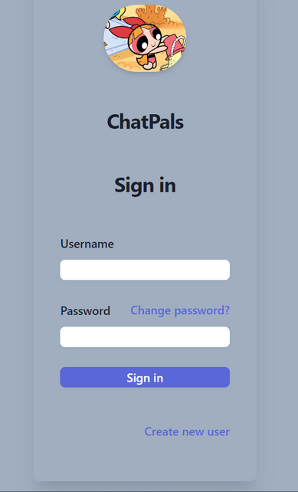
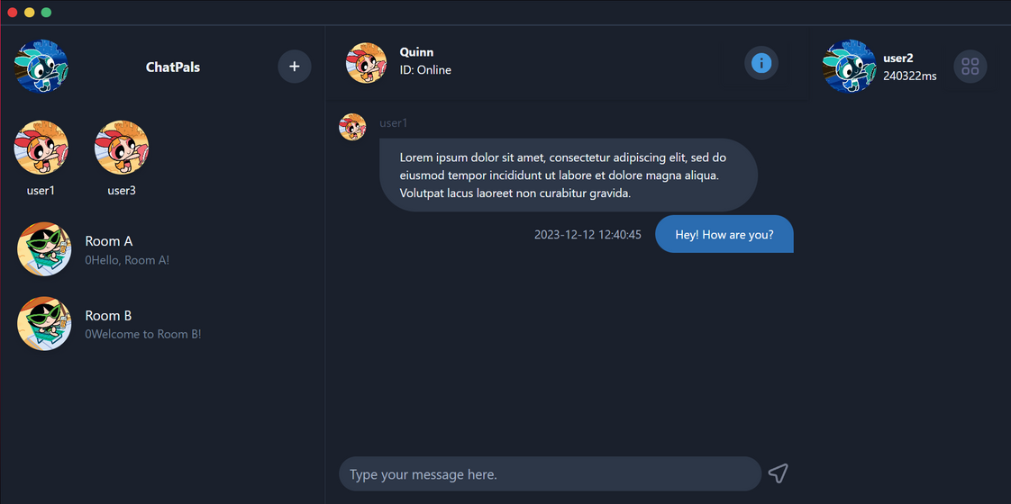
9. FUTURE PLANS
1. Deploy GUI of the project:
We are deploying a GUI program using GTK3 and WebkitGTK with HTML5 UI
(still facing with some problem with data binding)
Hello!
34.
Hi! Nice to meet you.

Slide 35
9. FUTURE PLANS
2. Enlarge the database for store more user information:
Media file storage
History user activity log
User unread message
Archive message
3. Implement security method
Encrypt user, conversation information on database
Encrypt application protocol
4. File, media sharing
Send picture, audio along with messages
Hello!
35.
Hi! Nice to meet you.

Slide 36
10. PROGRAM DEMONSTRATION
Hello!
36.
Hi! Nice to meet you.

Slide 37
THANK YOU FOR LISTENING!
Hello!
37.
Hi! Nice to meet you.

